Slide 1

Section 0. Outline of workshop and introductions
Section 1. Starting your research project:
What makes a research question viable?

Slide 2
Outline
Introduction
Section 1. Starting Your Research Project
Section 2. Practical Tips for Writing Your Applied Paper
Section 3. Presenting Your Research
Section 4. Q&A Session
Section 5. The Publication Process
Section 6. Refereeing
Section 7. Presenting Your Event-study Estimates
Section 8. Conferences and Networking (optional and if time permits)
Section 9. Ask the Editor + Q&A Session

Slide 3
Who am I?
Mark Anderson (Prof. of Economics, Montana State University, NBER and IZA) and Dan Rees (Prof. of Economics, Universidad Carlos III de Madrid and IZA)
Applied microeconomist working primarily at the intersection of health economics and economic history
User of well-defined natural experiments and methods such as DD and IV
Passionate about the research process and the crafting of a research paper
Recently, I have written on topics such as…
Public health and mortality at the turn of the 20th century
Hospital desegregation during the civil rights era
Civil rights protests and election outcomes
The effects of becoming a physician on prescription drug use and mental health treatment
Marijuana legalization (too many papers on this topic…)

Slide 4
What is this course?
A hidden curriculum
What I wish we would have learned as graduate students/asst. prof. on…
Research process
Writing papers
Publishing
Other stuff (refereeing, presenting research, etc.)
There is a template for doing good applied research, and I hope to share that with you
Series of 10- to 30-minute lectures
Plenty of time set aside for Q&A in between and after each topic
Will do my best to stick to the schedule but may improvise slightly

Slide 5
Starting Your Research Project
What makes a research question viable?
The three hurdles:
(i) Is it interesting/important/policy relevant?
(ii) Are you filling a clearly defined gap in the literature?
(iii) Are the data available? Does a well-defined natural experiment exist?

Slide 6
Hurdle #1. Is it interesting/important/policy relevant?
How do I know if my idea is interesting?
Seems interesting to me, but…
Pitch your idea broadly, especially to other economists who you know will be critical
Try-to-kill-my-idea sessions
Pitch your idea to non-economists.
I still pitch my ideas to my father (and he is a retired dentist)
My wife hates all of my ideas…
If it is interesting, does that mean it is “important”?
Yes! Which leads to…
Does my idea have to be policy relevant?
It depends
Consider the U.S. mortality transition…

Slide 7
Is there policy relevance to explaining the urban mortality transition?
Sure, maybe. But, trying to better understand what has been called “one of the most significant developments in the history of human welfare” is interesting in and of itself!
Don’t force a project to be policy relevant if it isn’t or, more importantly, doesn’t need to be

Slide 8
Hurdle #2. Are you filling a clearly defined gap in the literature?
Become an expert of the relevant literature.
How do I do this?
For each project, I create a literature-review binder
1.) Start with econ-specific search engines (e.g., JSTOR, Econ Lit, NBER WP, etc.) before doing more general searches on
engines such as Google Scholar
2.) Sort by theoretical vs. empirical
3.) Sort by how well the papers published
4.) Sort empirical papers by the credibility or type of research design
Cross-sectional vs. panel
IV vs. DD vs. RD
If you do this, you will know exactly how you are building on existing studies.
Do not learn the lesson the hard way…

Slide 9


Slide 10
Hurdle #3. Are the data available? Does a well-defined natural experiment exist?
Hardest hurdle. Do not assume the data exist…get on this yesterday!
Even if data exist, collecting/cleaning/etc. can be a heavy lift…get on this yesterday!
Data on X and Y are available, but I do not have a well-defined natural experiment. Should I dump the idea?
As a grad student trying to write your JMP, you should probably dump it.
As a junior prof. trying to get tenure, you should probably dump it.
Maybe you can pivot to a non-econ journal, but this takes time
You can become a structural labor economist, but then you won’t have any friends.
Just kidding!
Not really

Slide 11
Hurdle #3 (continued)
Start with hypothesis of interest and then try to identify a natural experiment
vs.
Observe a natural experiment and then come up with a question
Some “old-school” folks think the pure form of research is to do the former.
Impractical
Miss out on a lot of good topics
Always have your natural experiment radar on…”one does not know where an inspiration will come from.”

Slide 12
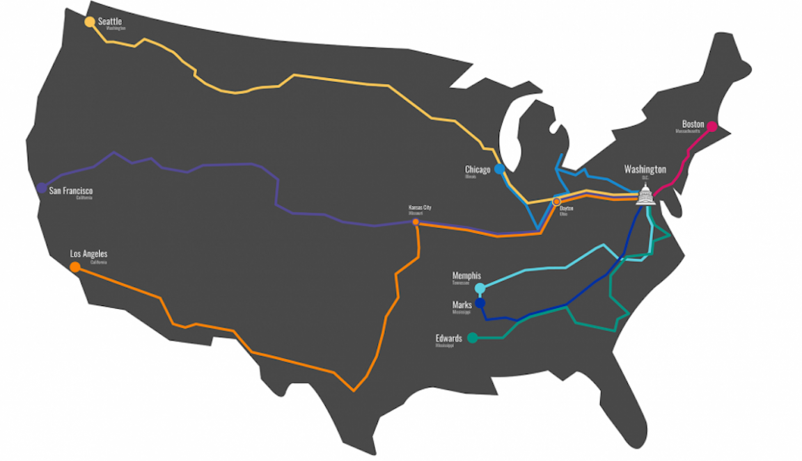

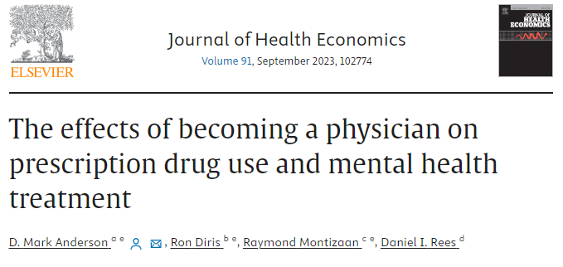
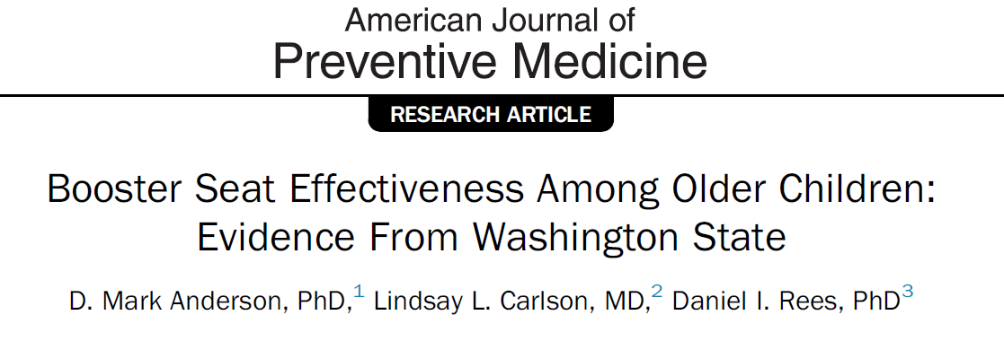
My trip with Dan Rees to the Smithsonian Museum of American History
“Lively discussions” with my wife
Poor People’s Caravan – March on D.C. to demand economic and human rights for poor Americans of diverse backgrounds in 1968.

Slide 13

Bleakley and Ferrie’s QJE on Georgia land lotteries
But, most importantly, become an expert of institutional details, the historical context, etc. of your areas of interest.
Do this and ideas will naturally come!

Slide 14
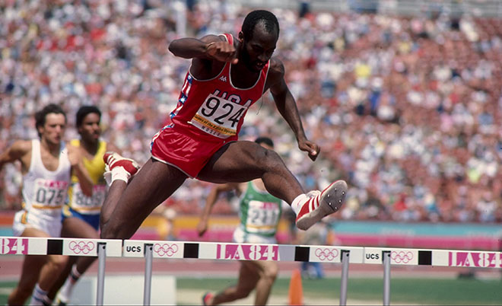
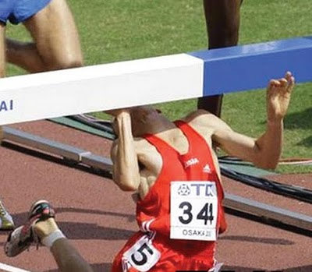
If you can get over these 3 hurdles, you are off to the races!
If you can’t, get back up, and go back to the drawing board.
Edwin Moses, the greatest 400m hurdler of all time

Slide 15
Short break

Slide 16
Section 1. Starting your research project:
When to cut the cord

Slide 17
When to cut the cord on a project
You’ve cleared the 3 hurdles, but when do I call it quits?
As a graduate student trying to come up with a great JMP or a jr. prof. trying to get tenure, this can be a make-it or break-it decision.
When does this come up?
1.) Null results
2.) Cannot identify mechanisms
3.) Something better comes along

Slide 18
The Null Result
Zero is a number too! But, is it always interesting?
No effect of minimum wage hike on unemployment
Interesting and policy relevant zero.
What about the relationship between prenatal exposure to the Super Bowl and low birth weight (Duncan et al. 2017, JHR) or the relationship between minimum wages and traffic fatalities (Adams et al. 2012, RESTAT)?
Probably only interesting if you find an effect.
High risk-high reward projects
Null effect would not make for a good JMP
Null effect would not publish well.
Does this cause a type of file-drawer bias? Sure.
Be practical when weighing the trade-offs between which projects to pursue and which ones to quit.
Zero is a number too, but only if it is precise!
Big difference between pitching a tight vs. noisy zero.
If 95% CI contains large values on either side of zero, we do not learn much.

Slide 19
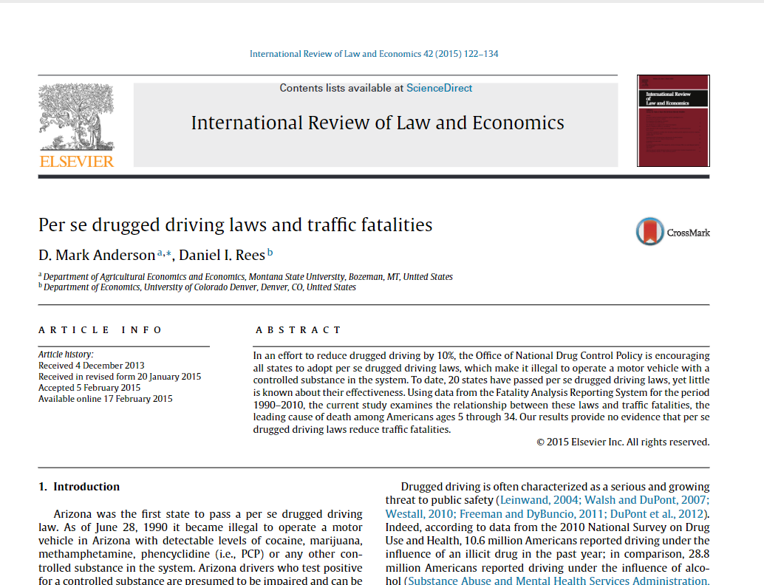
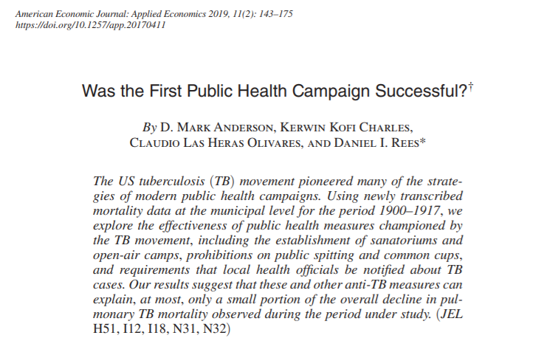
The Null Result
Imprecise zeros, not as well
Precise zeros can publish well
If null is interesting/policy relevant and precise, then proceed!
-But, know that the burden of proof can be much higher.
-We will discuss framing a precise zero later.

Slide 20
Identifying Mechanisms
Suppose you have a great natural experiment, but can’t pin down mechanism(s).
Death sentence?
Not necessarily! It depends on the topic…
Medical marijuana laws (MMLs) → traffic fatalities (Anderson et al. 2013, J of Law and Econ)
MMLs → 8 to 11% decrease in traffic fatalities
Effect driven by alcohol-related crashes
Plus, beer sales and self-reports of binge drinking fall
Without shedding light on mechanism, would not have published very well.
An ok, but not great, job market paper.

Slide 21
Identifying Mechanisms
Military deployments → crime (Anderson and Rees 2015, J of Law and Econ)
Increases in the number of never-deployed combat brigades at Fort Carson, CO → more violent crime
In contrast, previously deployed brigades do not cause crime
Never-deployed units represent a greater threat to public safety…why?
Unable to say much
But, (interesting) results ran counter to common perception and paper published well
Medical marijuana laws (MMLs) → suicide (Anderson et al. 2014, American J of Public Health)
MMLs → reductions in suicides among young adult males
Policy relevant? Yes.
General interest (within econ) without mechanism(s)? Probably not.
Low ceiling within econ journals
Not a great JMP
Recommendation: Move on or pivot to a non-economics journal
Flagship journal in public health

Slide 22
Identifying Mechanisms
Try to gauge early on whether you will be able to address underlying mechanisms.
Maybe consider this hurdle #4.
Try to gauge early on just how crucial it will be to address underlying mechanisms.
If you end up sinking a lot of time into a project and cannot address mechanisms, you can pivot to a non-economics journal (more on this in our next section)

Slide 23
Q&A/short break

Slide 24
Section 1. Starting your research project:
Managing your research projects

Slide 25
Managing your research projects
Allocating your effort
As a graduate student
Goal: Top-notch JMP.
Your efforts can be more concentrated
Not so much as a junior professor trying to get tenure.
That said, do not underestimate the value of a non-JMP publication.
Can be really important when you aren’t from Harvard, Yale, Chicago, etc.
I went to a top 50-ish school and it was very clear that having a good publication and RR was vital to obtaining interviews
At Montana State University, we have interviewed grad students from lower-ranked departments solely because they had a strong publication on their record
You do not have to work on a dozen papers as a graduate student.
Takes time away from JMP
Sends a quantity (as opposed to quality) signal, which is not always a good thing

Slide 26
Managing your research projects
Allocating your effort
As a junior prof.
Goal: A portfolio of projects at different phases
(i) Always have one to two projects that are your main focus
Some can manage more.
(ii) As you progress, always try to have at least a few papers under review or at the RR stage
(iii) When your papers in (i) are submitted, make sure data collection efforts are already under way on other projects.
If you have RA resources, spend them here.
If going into (or are already in) academia, figure out tenure requirements asap!
Helpful advice given to me: “You’re in an ag. economics department, so do not forget that quantity matters.”

Slide 27
Managing your research projects
Targeting journals
FAQ: “Where should I send paper X?”
If you become a master of the literature (as discussed earlier), the set of relevant journals will be clear
In Section 4, we will discuss this in detail. Stay tuned…
When to target a non-economics journal
You need to pivot because…
Estimates are correlations only
You cannot identify mechanisms
You just don’t have enough “meat” for a full-length paper
You need a mental health break!

Slide 28
Managing your research projects
Every summer, I take a break from the econ paper grind and write a paper for a medical journal.
It’s fun!
Important to learn how to write for a different audience
Transferable human capital
Papers for non-econ journals take much less time
Medical journals have word (≈3,000-4,000) and figure (≈4-5) limits
“Research letter” options
Word (< 1,000) and figure (≈1-2) limits
Only a few good econ journals have “letter” or “note” options.
Faster turnaround (< 1 month)
But, non-econ pubs do not “count” as much on the econ job market or for tenure in an econ department
Carefully weigh tradeoffs of pursuing these pubs vs. simply quitting (or not starting) a project altogether.

Slide 29
Q&A/Break

